Slide 2
Introduction
What is IOT
Internet of Things (IoT): The Internet of Things (IoT) is a network of physical objects or people called “things” that are embedded with software, electronics, network, and sensors which allows these objects to collect and exchange data.
The Internet of Things (IoT) is changing the way businesses operate around the world. It is helping different businesses open up new revenue streams, improve efficiency across the board and get a clear view of their supply chains, assets and operations
Types of IOT
IOT Types
Types | Single Profile SIM | Dual Profile SIM/ESIM | IIOT(Integrated IOT) Billing: MUM Circle only
Billing Identifier |  | COF-VITSL-MUMBAI Circle | COF-VITSL-MUMBAI Circle

Slide 3
History Of IOT
1970- The actual idea of connected devices was proposed
1990- John Romkey created a toaster which could be turned on/off over the Internet
1995- Siemens introduced the first cellular module built for M2M
1999- The term “Internet of Things” was used by Kevin Ashton during his work at P&G which became widely accepted
2004 – The term was mentioned in famous publications like the Guardian, Boston Globe, and Scientific American
2005-UN’s International Telecommunications Union (ITU) published its first report on this topic.
2008- The Internet of Things was born
2011- Gartner, the market research company, include “The Internet of Things” technology in their research

Slide 4
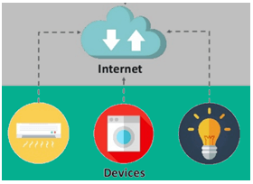
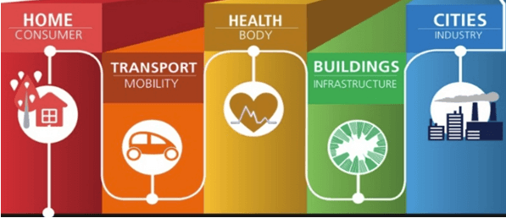
How IOT Works
The entire IoT process starts with the devices themselves like smartphones, smartwatches, electronic appliances like TV, Washing Machine which helps you to communicate with the IoT platform.
IoT Applications

Slide 5
SIM and Its Parameters

Slide 6
SIM Parameters
What is SIM Card
A SIM card, also known as a subscriber identity module, is a smart card that stores identification information that pinpoints a smartphone to a specific mobile network. Data that SIM cards contain include user identity, location and phone number, network authorization data, personal security keys, contact lists and stored text messages. SIM cards allow a mobile user to use this data and the features that come with them.
Without a SIM card, some phones would not be able to make calls, connect to internet services such as 4G LTE or send SMS messages. SIM cards are removable and have anywhere from, 32KB to 128KB
What is IOT SIM Card
An IoT/M2M SIM card is a variation of traditional SIM cards used in personal mobile devices like smartphones that have additional features designed for IoT devices. This includes things like being more durable, secure, and flexible
MSISDN
MSISDN (Mobile Station Integrated Services Digital Network) is the phone number which identifies a device during calls or data sessions. It performs a crucial function in ensuring secure connectivity between the different components within an IoT network

Slide 7
SIM Parameters
SIM Number
SIM card numbers are the unique identification numbers on a SIM (subscriber identity module) card that store information for an individual cell phone user. An example of SIM card numbers are the card's unique serial number and the internationally unique number of the cell phone user
IMSI Number
IMSI (International Mobile Subscriber Identifier) is a number of 14-15 digits which identifies a mobile subscriber by their SIM card. It is made up of several parts, including a country code, a network code, and an individual string of digits identifying each particular card within the mobile network.
This unique number is stored on the SIM card itself and is not moved or changed in the case that the mobile phone number (the MSISDN) is ported to a different SIM card. This allows companies to check the IMSI of a subscriber, to cut down on SIM swap fraud
Access Point Name (APN)
An Access Point Name (APN) is a gateway between a GSM, GPRS, 3G or 4G mobile network and another computer network, frequently the public Internet. A mobile device making a data connection must be configured with an APN to present to the carrier. The APN is used to find the right IP address that the device should be identified with on the network, determine if a private network is needed

Slide 8
SIM Parameters
SIMEX
The process of changing from an existing SIM to a new SIM, without changing the mobile number is called as SIM Exchange. Some reasons a customer would opt for a SIM Exchange are blocked, faulty, damaged and lost. After completion of SIMEX, all the services active on the old SIM will be carried forward to the new SIM
E-SIM
An eSIM is an ‘embedded’ SIM or a virtual SIM. When an eSIM is activated on the main device i.e., the phone, the device is referred to as a ‘Primary Device’. When the eSIM is used on another device like an Apple watch, the device is referred to as a ‘Secondary device’. Customers with compatible devices can use their phone as a dual SIM, with one eSIM and one Physical SIM with two different numbers and accounts.
IoT eSIM
With ViTM IoT eSIM - our embedded IoT SIM solution, you get the flexibility to remotely switch the Mobile Network Operator (MNO) of your IoT devices, without changing the SIM card. This enterprise-grade, highly resilient IoT solution ensure that your business enjoys secure connectivity through embedded hardware, reduced costs through consolidation of network profiles, and a reduced hardware size - resulting in sleeker, more compact device designs.

Slide 9
SIM Parameters
ViTM IoT eSIM’s are:
Capable to switch to Network profiles/operators automatically, on the basis of network availability, or manually, over the air (OTA) in real-time
Available in all SIM form factors for integration across MFF2 devices
Enterprise-grade build, to ensure performance even in harsh weather conditions, with an operating range of -40°C to +105°C and a storage range of -40°C to +125°C
Bundled with our IoT Connectivity Management Platform (CMP) a remote provisioning, visibility and management platform for IoT eSIMs, across networks
Designed to last with a long product life of up to 17 years at 85° C
Embedded into the hardware with pre-configured profile slots, thus ensuring high grade security with no scope for tampering or loss

Slide 10
IP Assignment Process-Static and Dynamic

Slide 11
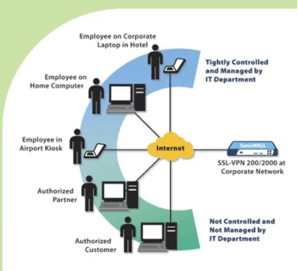
IP Address
What is IP(Internet Protocol)
An IP address is a unique address that identifies a device on the internet or a local network. IP stands for "Internet Protocol," which is the set of rules governing the format of data sent via the internet or local network.
An IP address is a string of numbers separated by periods. IP addresses are expressed as a set of four numbers — an example address might be 192.158.1.38. Each number in the set can range from 0 to 255. So, the full IP addressing range goes from 0.0.0.0 to 255.255.255.255.

Slide 12
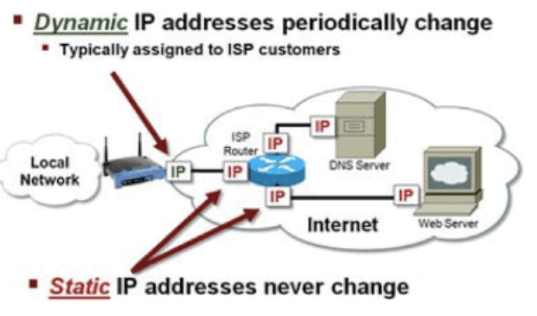
IP Assignment Process-Static and Dynamic
The basic rule is simple: every network device is assigned a unique IP address. There are two types of IP addresses, static or dynamic. The difference between static and dynamic IP address assignment is that dynamic IP addresses are on an as-needed basis, while static IP addresses usually are on a permanent basis.
What is the difference between a dynamic and static IP address?
When a device is assigned a static IP address, the address does not change. Most devices use dynamic IP addresses, which are assigned by the network when they connect and change over time.

Slide 13
Thank you !

